Slide 1
Pharmaceutical dosage forms and drug delivery systems By Assistant Lecturer: Aula Jawad
Industrial Pharmacy II
Lab (1)

Slide 2
Definition of Industrial Pharmacy
The conversion of raw materials into certain dosage forms.
Or it is manufacturing, development, marketing, and distribution of drug products including quality assurance of these activities.
E.g.: Tablets, capsules, suspensions and ampoules.

Slide 3
Definition of dosage form
Dosage form is the mean by which drug molecules are delivered to sites of action within the body.
Drug (Active pharmaceutical ingredients ) Chemical compound intended for use in diagnosis, treatment, and prevention of disease.
OR The Active Pharmaceutical Ingredient (API) is the part of any drug that produces its effects.
Inactive ingredients may also be referred to as inert ingredients or excipients, and generally have no pharmacological effect.

Slide 4
Direct clinical use of the active drug substances is rare: Why??
Notes:
API handling and Accurate dosing can be difficult or impossible (e.g., potent drugs: low mg and µg doses). ▪ API administration can be impractical/unfeasible because of size, shape, smell/odour, taste and low activity. ▪ Some API are chemically unstable in light, moisture,O2 ▪ API can be degraded at the site of administration (e.g., low pH in stomach). ▪ API may cause local irritations or injury when they are present at high concentrations at the site of administration. ▪ Administration of active substance would mean to have no chance for modification (improvement) of its PK profile.

Slide 5
The need for dosage forms:
Protection
Protection from the external environment
2. Protection from degradation because of gastric juice.
To improve therapeutic activity
1.To provide optimal drug action directly to the site of action
2. Place the drug directly into the body orifices
3. To provide optimal drug action in the bloodstream
4. To provide rate-controlled drug action
5. To improve the bioavailability of drugs with a narrow absorption window
Notes:
Insertion of drugs into body cavities (rectal, vaginal)

Slide 6
To improve patient compliance
1. To maintain the accuracy of dose eg. Unit dosage forms
2. Reduction in frequency of dosing e.g. Sustained Release and Controlled Release.
3. To improve the physical properties of drugs eg coated dosage forms
4. Ease of handling & and administration

Slide 7
Dosage forms are classified according to:
Route of administration
2. Physical state
Oral
Topical
Rectal
Parenteral
Vaginal
Inhaled
Ophthalmic
Otic
Solid
Semi solid
Liquid

Slide 10
Solid dosage forms
Advantages
Unit dose system
Physical, Chemical, and Physiological stability and hence long shelf life
Economic
Ease of Transportation
Tasteless & and elegance
Disadvantages
System swallowing is difficult for children
The onset of action is slow and depends on disintegrating and dissolution.

Slide 11
Powder
Powders are solid dosage forms of medicaments that are meant for internal or external use.
They are available in amorphous and crystalline forms.
TYPES OF POWDERS
1. Bulk Powders for internal use e.g. fine powders or granules
2. Bulk Powders for external use e.g. snuff, dusting powders, tooth powder
3. Simple and compound powder for internal use.
4. Powders in the form of compressed tablets and tablet triturate.
5.Powders enclosed in sachets and capsule

Slide 12
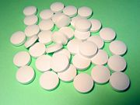
Tablet
Tablet: a hard, compressed medication in round, oval, or square shape.
Contains active ingredients and additives
They may vary in size, shape, hardness, thickness, weight, disintegration, dissolution characteristics, and other aspects.
Sublingual and buccal tablets are administered by placing them in the mouth, either under the tongue (sublingual) or between the gum and the cheek (buccal).
Examples of drugs administered by this route: e.g. vasodilators, steroidal hormones.

Slide 13
Effervescent tablet:
Effervescent tablets are uncoated tablets that generally contain acid substances (citric and tartaric acids) and carbonates or bicarbonates and react rapidly in the presence of water by releasing carbon dioxide.
They are intended to be dissolved or dispersed in water before use providing:
Very rapid tablet dispersion and dissolution. Rapid onset of action
pleasant tasting carbonated drink.

Slide 14
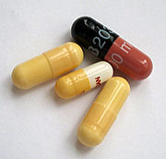
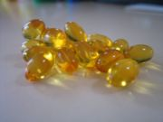
Capsule:
Hard gelatin capsule
Soft gelatin capsule
A capsule is a medication in a gelatin container.
Advantage: mask the unpleasant taste of its contents.
The two main types of capsules are:
1- hard-shelled capsules, which are normally used for dry, powdered ingredients,
2- soft-shelled capsules, primarily used for oils and for active ingredients that are dissolved or suspended in oil.

Slide 15
Lozenge:
It is a solid preparation consisting of sugar and gum, the latter giving strength and cohesiveness to the lozenge and facilitating the slow release of the medicament.
It is used to medicate the mouth and throat for the slow administration of indigestion or cough remedies.
Notes:
Pills are oral dosage forms which consist of spherical masses prepared from one or more medicaments incorporated with inert excipients.
Pills are now rarely used.

Slide 16
Liquid dosage forms

Slide 18
Liquid dosage forms
Advantages
Immediately available for absorption.
Easy to color, flavor & and sweeten.
Liquids are easier to swallow than solids and are therefore particularly acceptable for pediatric patients.
Some drugs like aspirin and KCl can irritate gastric mucosa if used orally as solid dosage forms. But this effect can be reduced by a solution system.

Slide 19
Disadvantage
Less stable in aqueous system. Incompatibility is faster in solution than in solid dosage form.
Patients have no accurate measuring device.
Accident breakage of container results in complete loss.
Solution often provides suitable media for the growth of microorganisms.
The taste of a drug, which is often unpleasant, is always more pronounced when in solution than in a solid form.
Bulky than tablets or capsules, so difficult to carry transport

Slide 20
Liquid preparations:
Oral solution:
Oral solutions are clear Liquid preparations for oral use containing one or more active ingredients dissolved in a suitable vehicle.
Oral emulsion:
Emulsions are the biphasic liquid dosage forms containing two immiscible liquids that are made miscible by the addition of a surfactant. *o/w emulsions *w/o emulsions
Oral suspension:
Oral suspensions are Liquid preparations for oral use containing one or more active ingredients suspended in a suitable vehicle.
Oral suspensions may show a sediment that is readily dispersed on shaking to give a uniform suspension that remains sufficiently stable to enable the correct dose to be delivered.

Slide 21
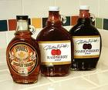
Liquid preparations (Cont.):
Syrup:
It is a concentrated aqueous solution of a sugar, usually sucrose.
Flavored syrups are a convenient form of masking unpleasant taste.
Elixir:
-It is a flavored, clear, aromatic hydroalcoholic liquid oral preparation intended for oral use.
The vehicle may contain a high proportion of ethanol or sucrose together with antimicrobial properities which confers the stability of the preparation.

Slide 22
Semisolid dosage forms
ADVANTAGES:
1. Site-specific application.
2. Convenient for unconscious patients.
3. Chemically stable.
4. Suitable for the bitter taste drugs.
DISAVANTAGES:
1. Staining by oily ointments.
2. Less dose accuracy.
3. Contamination when applied by fingertip.
4. Bulky to handle than solids

Slide 23
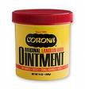
Ointments:
Ointments are semi-solid, greasy preparations for application to the skin, rectum ,or nasal mucosa.
The base is usually anhydrous and immiscible with skin secretions.
Advantage or usage:
Ointments may be used as emollients
or to apply suspended or dissolved medicaments to the skin.

Slide 24
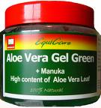
Creams:
Creams are viscous, semi-solid emulsions
Aqueous cream
Oily cream
Gels (Jellies):
Gels are transparent, nongreasy semisolid systems in which a liquid phase is constrained within a 3-D polymeric matrix (consisting of natural or synthetic gum) having a high degree of physical or chemical cross-linking.
Notes:
They are used for medication, lubrication and some miscellaneous applications like carrier for spermicidal agents to be used intra vaginally .

Slide 25
Pastes :
Pastes are basically ointments into which a high percentage of insoluble solid has been added
The extraordinary amount of insoluble particulate matter stiffens the system.
Pastes are less penetrating, less macerating, and less heating, less greasy than ointment.

Slide 26
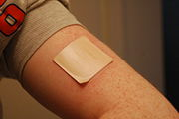
Transdermal dosage forms :
Transdermal patch:
A transdermal patch or skin patch is a medicated adhesive patch that is placed on the skin to deliver a specific dose of medication through the skin and into the bloodstream.
An advantage of a transdermal drug delivery route over other types such as oral, topical, etc is that :
it provides a controlled release of the medicament into the patient.
No first pass metabolism
Avoid the harsh environment of gastrum
The delivery of drug can be terminated at any time
E.g. scopolamine for motion sickness.

Slide 27
Parenteral dosage forms:
PARENTERAL DOSAGE FORMS An injection is an infusion method of putting liquid into the body, usually with a hollow needle and a syringe that is pierced through the skin.
Intravenous Injection • It is a liquid administered directly into the bloodstream via a vein.
It is advantageous when a rapid onset of action is needed.
Intramuscular Injection • It is the injection of APIs directly into a muscle.
Intramuscular injections
Subcutaneous Injection • It is injected into the subcutis, the layer of skin directly below the dermis and epidermis.
• It is highly effective in administering vaccines and insulin

Slide 28
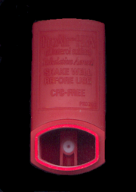
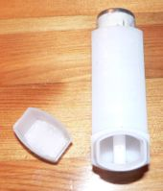
Inhaled dosage forms:
1- Inhaler :
Inhalers are solutions, suspensions or emulsion of drugs in a mixture of inert propellants held under pressure in an aerosol dispenser.
Release of a dose of the medicament in the form of droplets of 50 um diameter or less from the container through a spring-loaded valve incorporating a metering device. The patient then inhales the released drug through a mouthpiece.
It is commonly used to treat asthma and other respiratory problems.

Slide 29
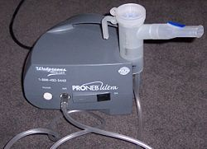
Inhaled dosage forms (Cont.):
2- Nebulizer or (atomizer):
A nebulizer is a device used to administer medication to people in form of a liquid mist to the airways.
- It pumps air or oxygen through a liquid medicine to turn it into a vapor, which is then inhaled by the patient.
Inhalers are better because:
1-These are cheaper
2- more portable
3- carry less risk of side effects.
Nebulizers, for that reason, are usually reserved only for serious cases of respiratory disease, or severe attacks.

Slide 30
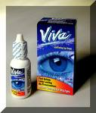
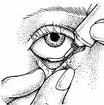
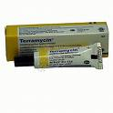
Ophthalmic dosage forms:
1- Eye drops:
Eye drops: solutions or suspension
Should be sterile, isotonic, buffered.
2-Ointments
3-In-situ gelling preparations

Slide 31
Nasal dosage forms:
Nasal Drops and Sprays:
Drugs in solution may be instilled into the nose from a dropper or from a plastic squeeze bottle.
The drug may have a local effect, e.g. antihistamine, decongestant.
Alternatively the drug may be absorbed through the nasal mucosa to exert a systemic effect.
The nasal drop should be isotonic having neutral PH and viscosity similar to the nasal secretions
The use of oily nasal drops should be avoided because of possible damage to the cilia of the nasal mucosa.

